Slide 1
Regional Logistics Expo 2019
“Innovative & Sustainable Solutions for Freight Logistics.”
Block Chain Enabled Logistics Management for Efficiency and Traceability
FOR FROM
BY

Slide 2

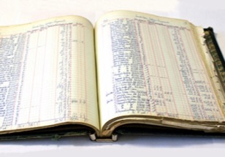



Addressing Underlying Challenge
A shared replicated, permissioned ledger ensures consensus, provenance, immutability and finality
Append-only distributed system of record shared across business network
A network of trusted, neutral participants maintains a distributed, permissioned ledger with copies of document filings, relevant supply chain events, authority approval status, and full audit history; every change results in a new, immutable block.
Business terms embedded in transaction database & executed with transactions
The export and import documentation requirements and authority approvals are pre-programmed and built into Blockchain and distributed to and endorsed by the network
Shared ledger
Smart
contract
Ensuring appropriate visibility; transactions are secure, authenticated
& verifiable
Cryptography enables permissioned access for only participating parties in a specific shipment can submit, edit or approve related data
Transactions are endorsed by relevant participants
Information such as documentation filings and authority approvals can only be changed if endorsed by the parties taking part in the shipment; full audit history maintained on the Blockchain
Privacy
Trust

Slide 3

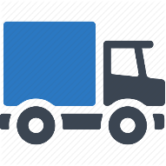







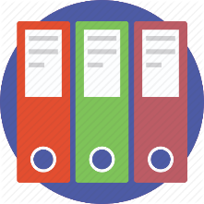




Current View Of Traceability And Transparency In Supply Chain
Customer found faulty food
Farm Produce
Record
Record
Record
Food Processing
Distributors
Stores
Complain Registered at Store
Result
Dissatisfied Customer
Case Investigator checking with all Supply Chain stakeholders separately and doing math's to find the point of fault.
Food item from all stores called up to avoid further harm.
It took weeks to trace the product
Store Manager
(Investigating the source of rotten food)

Slide 4
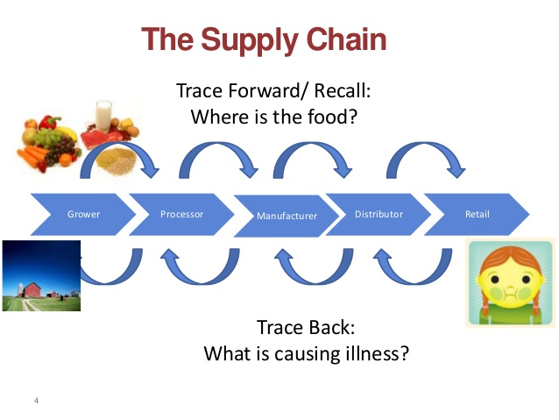
Traceability
Traceability is the ability to identify the origin of food and feed ingredients and food sources, particularly when products are found to be faulty. It is also called one step back one step forward principle.

Slide 5

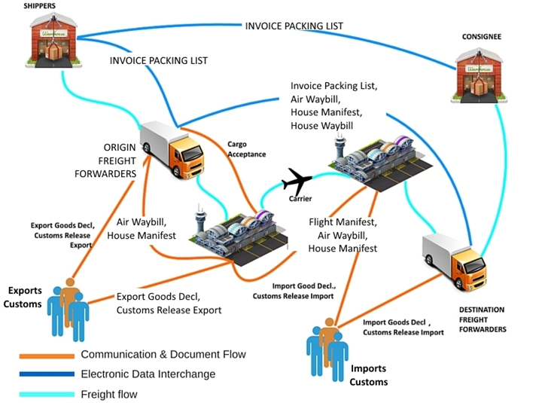
Middlemen & Document Processing
Lengthy documentation process
Duplicate/ repeated information entry at international borders
Lengthy manual compliance process post clearance
Multiple middlemen interventions and decrease customer experience and border congestions
www.TechnoBrainGroup.com
Notes:
Take an image of trader in Zambia – shipment is agreed to be supplied from China

Slide 6
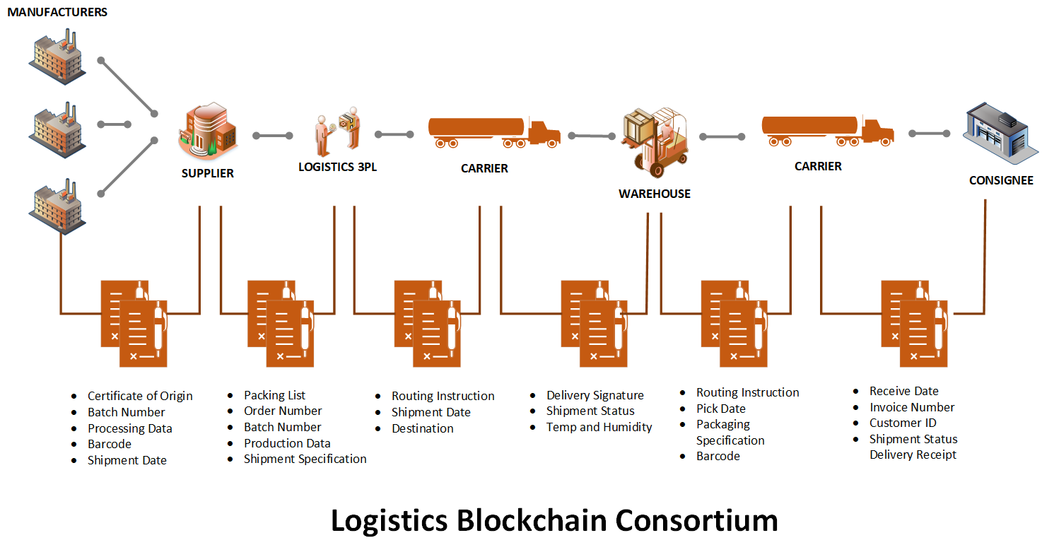
Logistics Inefficiencies solved by Blockchain

Slide 7
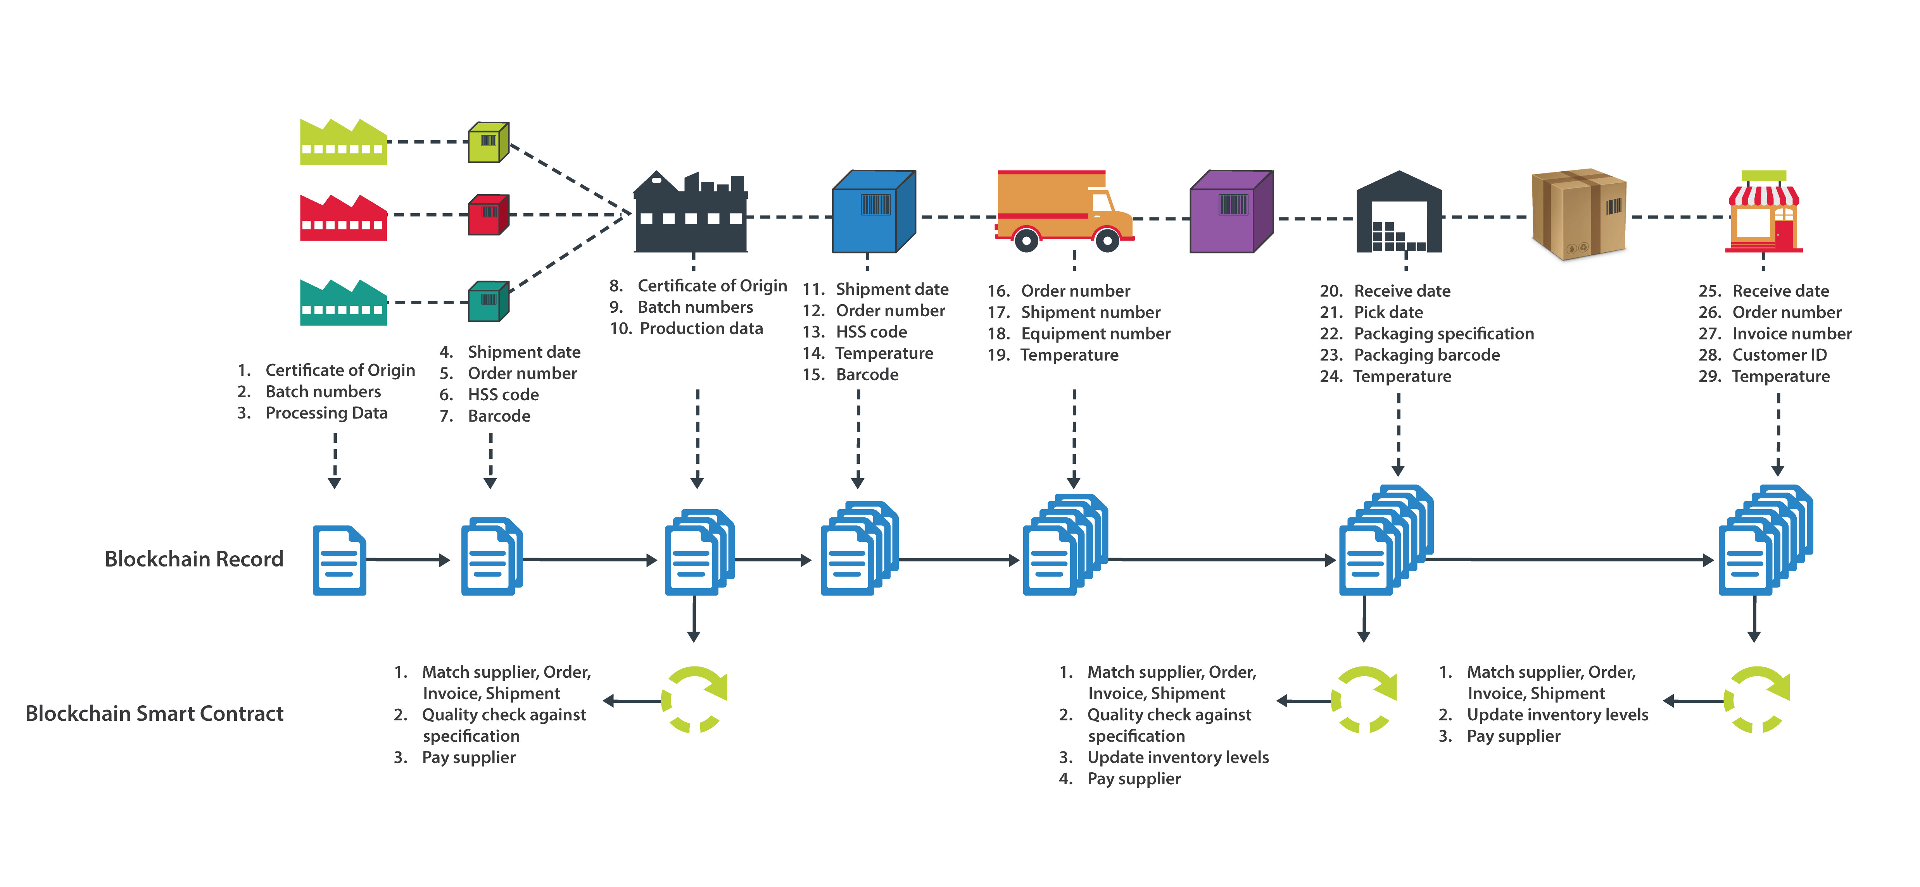

Holistic View of traceability and transparency in Supply Chain using Block chain
At any point of time any of the stakeholder from farm producer to end customer can trace the product and see other related information
Transparency and Traceability

Slide 8
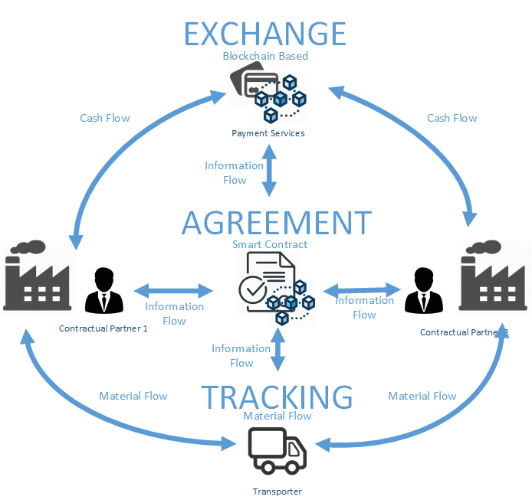
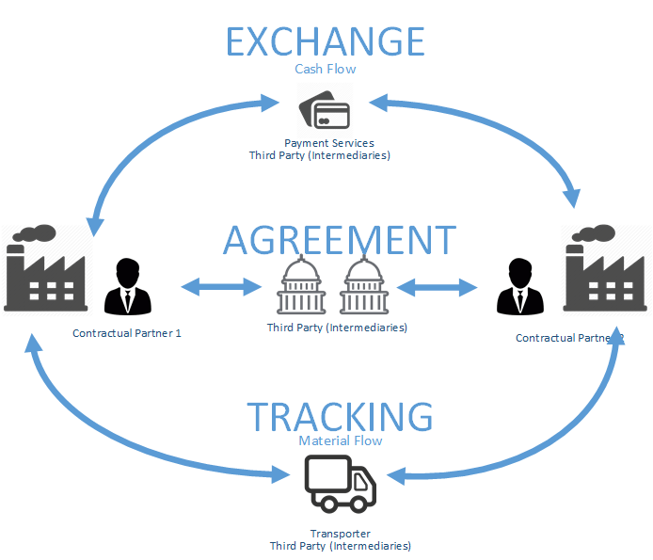
Blockchain Transforming Supply Chain
Blockchain can manage the Payments, Agreements, or Tracking Process effectively in typical supply chain process where multiple stakeholders are involved (partner, supplier, and clients).
Traditional Supply Chain
Supply Chain using Blockchain

Slide 9
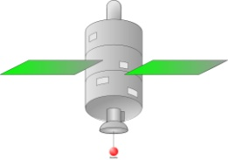
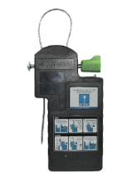


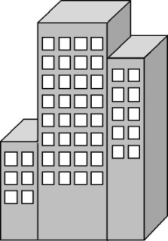
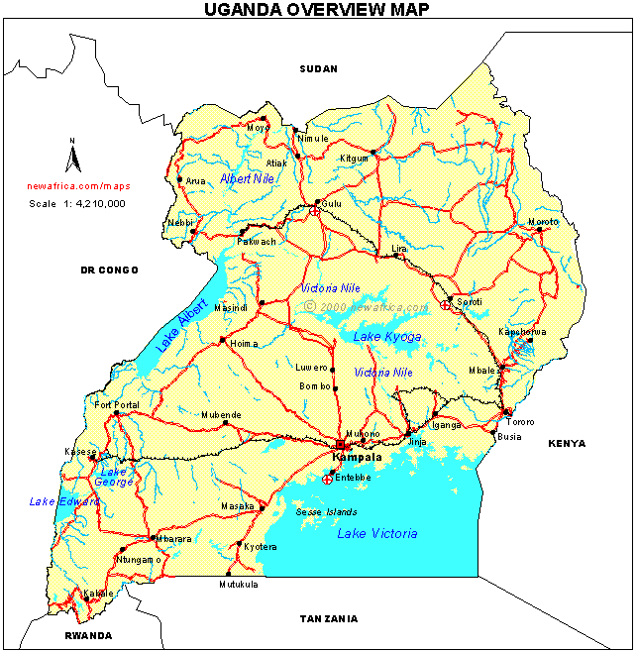






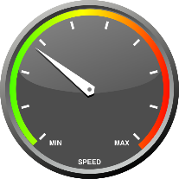




Functional Flow
Transit Starts
GSM Network
GPRS
Transit Ends
GPS Satellite
Truck attached with Master & Slave
Communication Network
HQ / Control room
Sends Alarms
Checks for Geo fence Alarms and locates the current position of the vehicle on Google Maps.
Shows Snail Trail.
Checks Battery Status of Master and Slave
Checks Seal Tamper, Seal Opened ,Seal Closed
Gets Start time and End Time of Transit i.e. Duration of Entire Trip
Checks Security Switch Open, Security Switch Close
Checks Over Speeding
Alarm Officer handles Alarm & Collects Fines
Reaction Team goes and checks issue

Slide 10

How it works? Our Approach and Design
1. Durban Port
2. Zimbabwe
3. Zambia
Shipment Cleared from Durban Port
Transaction Initiated and Recorded
Shared Ledger Created based on Destination
SARS starts transit cargo management process.
Alarms and Exceptions recorded and handled
Global status updated
RIT received at Beitbridge
Automatic transaction handshake at border
Transaction Validated and recorded
ZIMRA starts transit cargo management process.
Alarms and Exceptions recorded and handled
Global Status Updated
Shipment received at Chirundu.
Automatic transaction handshake at border
Transaction Validated and recorded
ZRA receives cargo for customs clearance.
Shipment marked closed in Blockchain
Global Status Updated
Data Privacy
Country Specific Transaction information stored locally.
Data Privacy
Country Specific Transaction information stored locally.
Data Privacy
Country Specific Transaction information stored locally.
Data Protection
Data Protection
Data Protection
South Africa - Ledger
Zimbabwe - Ledger
Zambia Ledger
Update Status and Transaction information
Update Status and Transaction information
Update Status and Transaction information
Global Transit Information Ledger/ Node

Slide 11
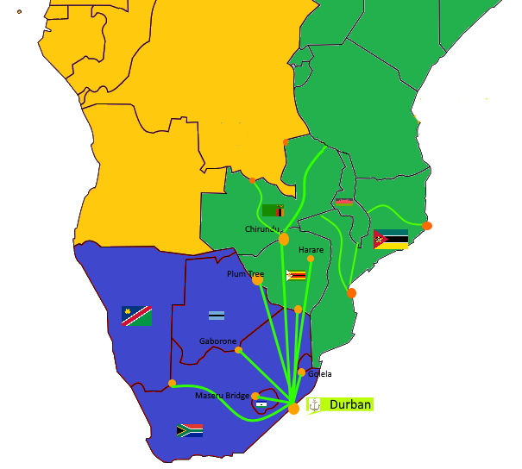
What is Missing?
Single Transit Corridor – Fast tracking transit handover at Entry / Exit Border Stations
Shared Transit Information from Port of Origin
Data Privacy on Shared Transit Ledger – Controlling country specific data on shared network
Immutable transaction for increased transparency and increased trade facilitation between countries.

Slide 12
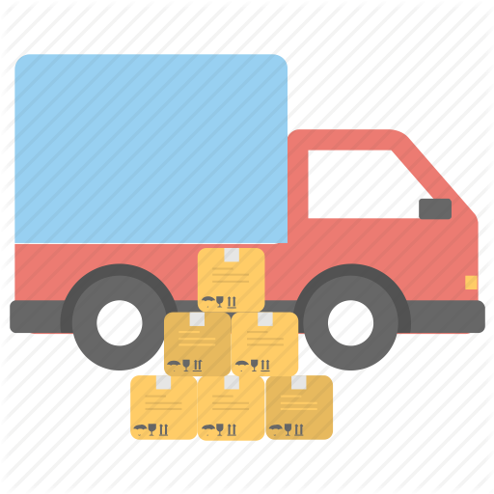





Application of Blockchain in Logistics and Supply Chain
  Efficient Shipping Process
  Transparent and error free Invoicing and Payments
  Inventory Tracking
  Settling Disputes
  Better Transparency

Slide 13


2nd Fastest Growing Technology Company in Africa
Ranked 6th in KPMG Top 100 Mid-Sized Companies in Tanzania
Appraised at CMMI L5. The Only Company in Africa
Winner - East Africa Entrepreneur of the Year

