Slide 1

Topic: “OIL & GAS CURRENT STATUS AND THE IMPLICATION ON BUSINESS AND THE ECONOMY AT LARGE”
By
Hon. Dr Elly Karuhanga-
Chairman, Uganda Chamber of Mines & Petroleum
@Regional logistics Expo 2019

Slide 2

Brief about UCMP
The Uganda Chamber of Mines & Petroleum (UCMP) is a non-for-profit organization representing the interest of the mining and petroleum sector in Uganda. UCMP is a coordinating and facilitating centre for information and administrative support to prospective and current investors in the mining and exploration sectors in Uganda.
WE ARE THE VOICE OF THE OIL, GAS & MINERAL SECTORS IN UGANDA
.

Slide 3
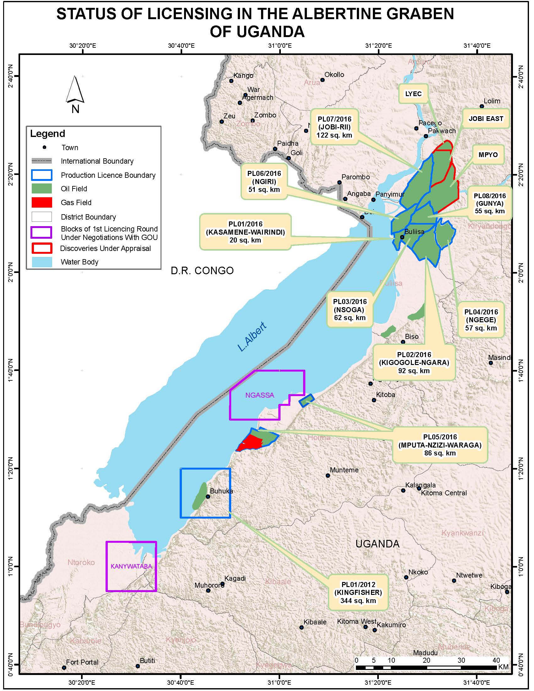
21 Oil and Gas discoveries; 14 fields under development
6.5 billion barrels of Oil equivalent in place; 1.4 billion barrels recoverable.
Gas (Non-associated) Initially In Place (GIIP) stands at 500 BCF.
40% of Albertine Graben has been explored; less than 15% is licensed.
Other sedimentary basins in the country are under investigation; example Moroto-Kadam Basin
5 Players; CNOOC, Total E&P, Tullow, Armour and Oranto
Policies, laws, regulations and standards, PSAs all in place

Slide 4
Current Status of the Sector
2.4 KEY PROJECTS
Road to First Oil ~ US$ 15 - 20 Billion Investment
Upstream Devt
Uganda Refinery Project
East Africa Crude Oil Pipeline
New Exploration, CPFs, Pipelines and access roads, camps
$ 8 bn
60,000 bpd Refinery, 211km products pipeline
$ 3-4 bn
~200,000 bpd
$ 3.55bn
Airport, Industrial Park, Roads
$ 1bn
Support Infrastructure
Opportunity for National Content Development
50% or more of the spend will be in the logistics sector.

Slide 5
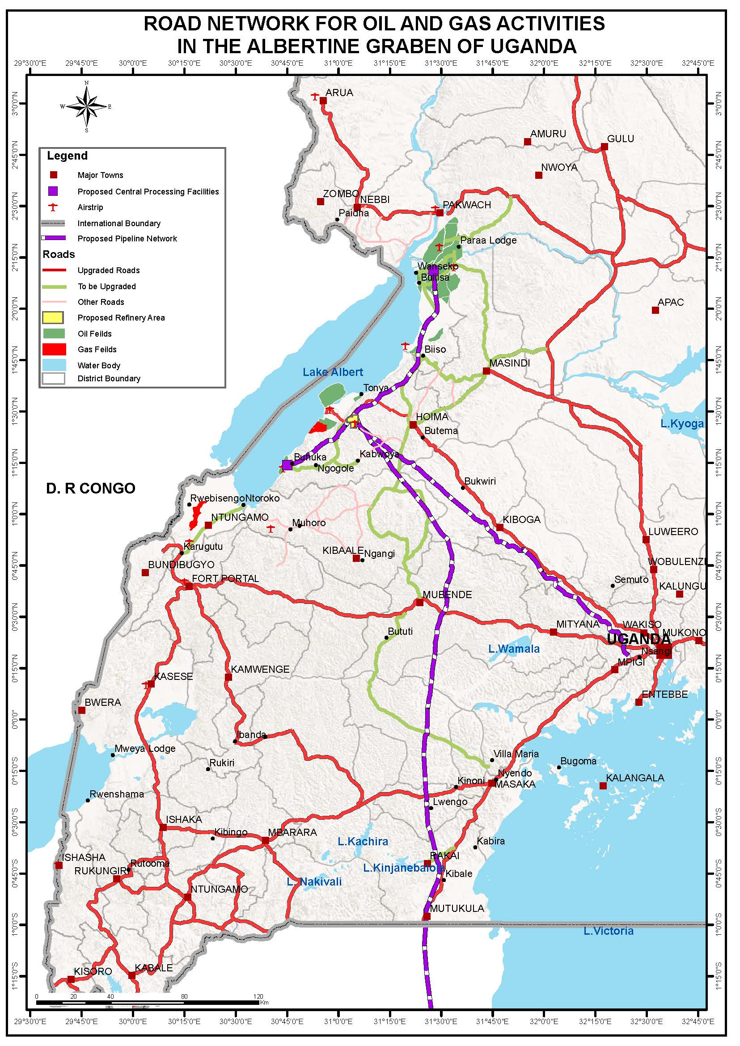
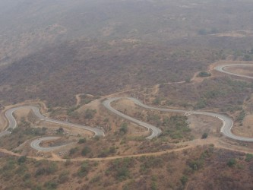
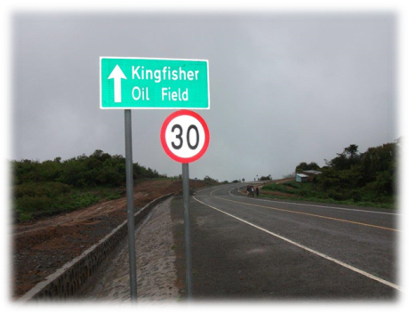
Key Projects
Planned network of 12 roads; 580 Kilometres at US $ 500 million
3 kilometre bridge
A Refinery,
An International Airport
A crude oil and products storage/ transmission hub,
Logistics warehousing
  Energy-Based Industries,
  Petrol Chemical Industries
  Other associated facilities.

Slide 6
IMPLICATION ON BUSINESS
Delays in commercial negotiations;
Delayed Local Content
Pressure on Businesses ( Acquired loans, etc)
Investor Fatigue / Frustration
Delayed Expected Employment
Subsided investor interest

Slide 7
IMPLICATION ON THE ECONOMY
Delays in commercial negotiations;
Approx. USD 20bn investment expected on Oil & Gas expected projects
This is two thirds of Uganda’s current GDP
Delayed Revenues to Govt
With such investment, it is possible to grow the GDP to double digits
Multiplier effect from the investment.

Slide 8
AS we wait for completion of negotiations
Oil and Gas at its peak is expected to require over1,000 trucks every month and over 2,000 professional drivers.
Opportunities in freight logistics will be in: supply chain management; freight forwarding; customs clearing; ware housing; transport; and lifting services among others
Compliance to Global standards – environment; health and safety standards
Skilling the Local Content
Enterprise development;
Use of locally produced goods and services
Transfer of knowledge and technology in the country.
Partnerships to over come capacity and financing challenges

Slide 9
Example: heavy goods vehicles requirements
Some of the HGV minimum Requirements.
vehicle vetting-mileage and age
maintenance scheme-plan/history
personnel (mechanics etc)training
3 point seat belts
ABS/EBS- Ant/Electronic Braking system
head rest for all seats
first aid kit and a flash light/torch
in vehicle monitoring system (VMS)
- Reversing alarm system
- under- run protection; front, side and rear
- fire extinguishers- atleast 5kgs dry chemical
- 2xsuitable spare wheel and repair kit, wheel chocks
-
warning triangle and reflective vest to be used when stepping aside a vehicle out of service
- Rollover protection (shall be fitted on any vehicle where risk assessment shows this is necessary)
- head board for flat bed trucks
- suitable tyres, same type of tyres

Slide 10
Example: heavy goods vehicles requirements
Mandatory vichicle/ equipment inspection prior to mobilsation to site
Requirement for escort vehicle on all HGV’S
A contractor HSE representative for all field projects.
Speed limits for all route/road types and regions.
No/zero drug & alcohol policy during projects
Mandatory tracking (VMS) to monitor compliance and other parameters.
Mandatory route assessments for every project prior to implementation.
Employee HSE training plan

Slide 11
Example: HGV & LIGHT VEHICLE DRIVERS requirements
General safety awareness
Basic mechanic knowledge(general vehicle inspections- tyre change, oil levels etc)
Driver assessed by approved driving examiner and passed in on road test
Training in dangerous good and special and special loads for drivers in this category
Valid driving license and class
2 years and above driving experience
21 years minimum age
Able to communicate – speak, read and write English
Certificate- defensive, off-road
Medical fitness certificate
First aid
Fire fighting

Slide 12

CONCLUDING REMARKS
Oil and gas sector in Uganda is broadening from exploration to development of discovered oil and gas resources together with refining and pipeline infrastructure development.
Efforts to ensure sustainable exploitation and utilisation of the resources are ongoing. You play a critical role.
All stakeholders must play their roles responsibly, with mutual respect and promote sustainable development and partnerships

Slide 13


Get in touch!
3rd Floor, Amber House
Plot 29/33 Kampala Road
P. O. Box 71797 Kampala Uganda
chambermp@gmail.com, info@ucmp.ug
www.ucmp.ug
+256-393-516695; +256-414-697674
Facebook: Uganda Chamber of Mines & Petroleum
Twitter: @ugandachamber

